Slide 1
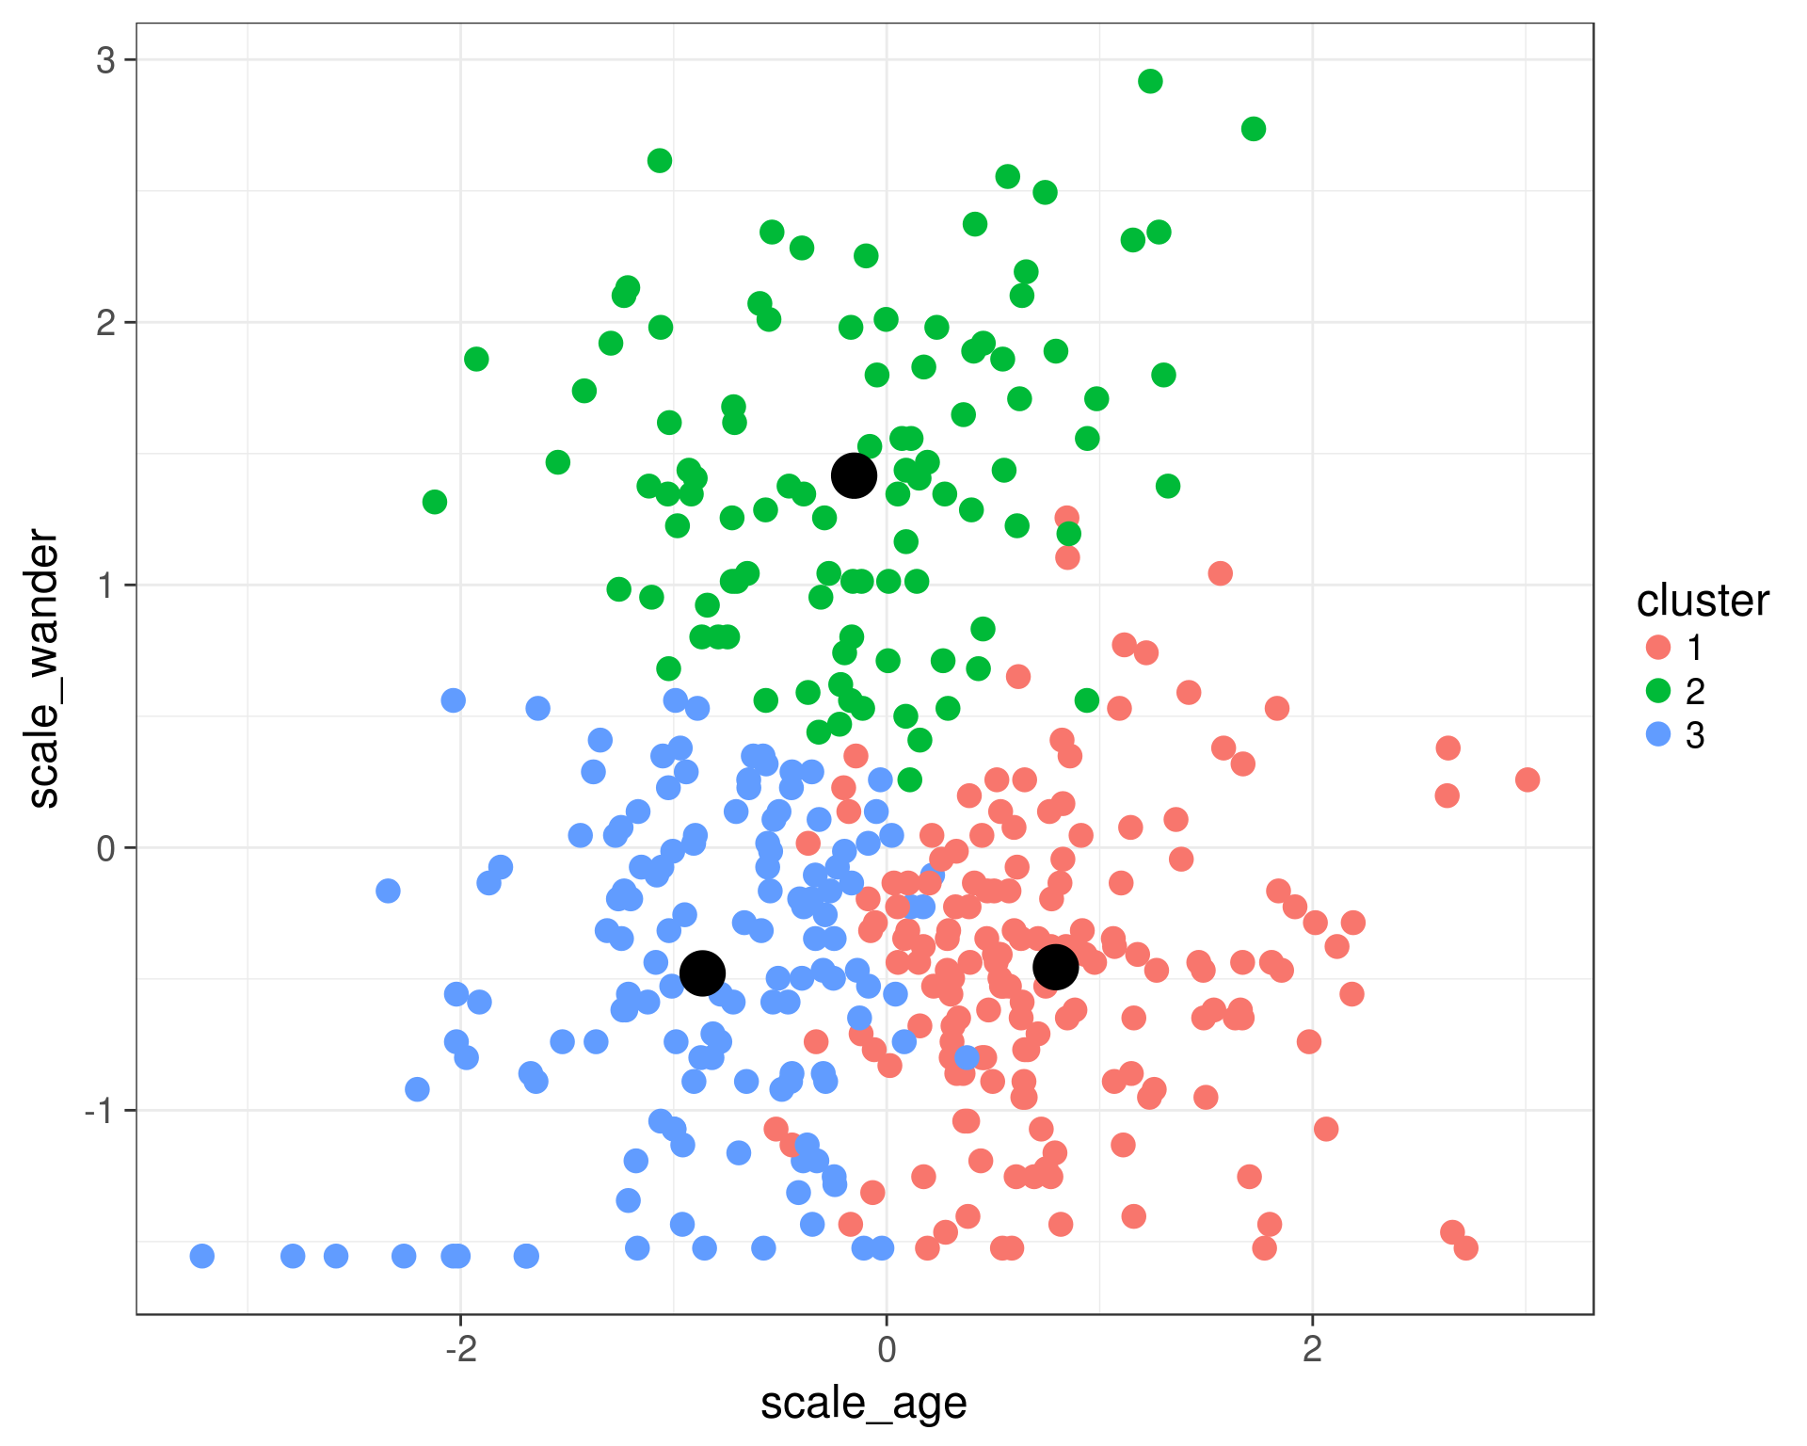
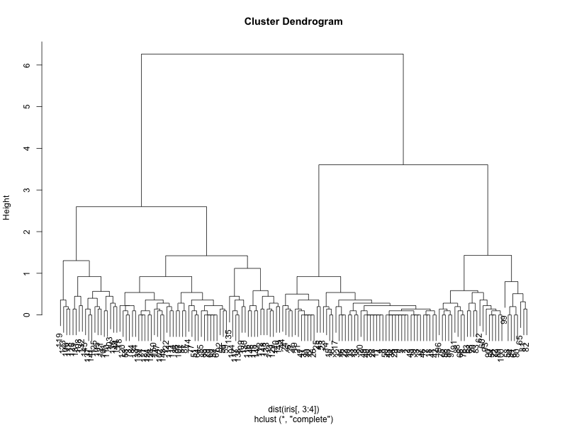
Week 11:Clustering and the final take home project
Geog4300: Shannon

Slide 2
Wrapping up!
Two final topics this week not used in labs:
Clustering: k-means/hierarchical cluster analysis
Spatial autocorrelation
Notes:
Alternative hypothesis is usually what you’re trying to prove.

Slide 3
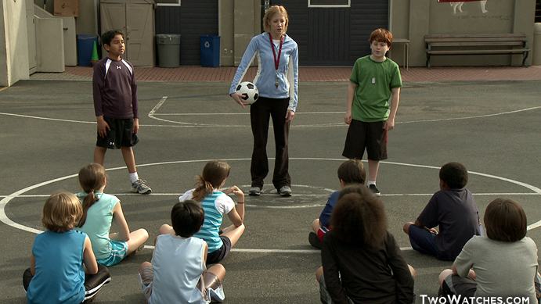
K-means
Picks a set number of “seeds” and then groups based on similarity.
Notes:
Alternative hypothesis is usually what you’re trying to prove.

Slide 4
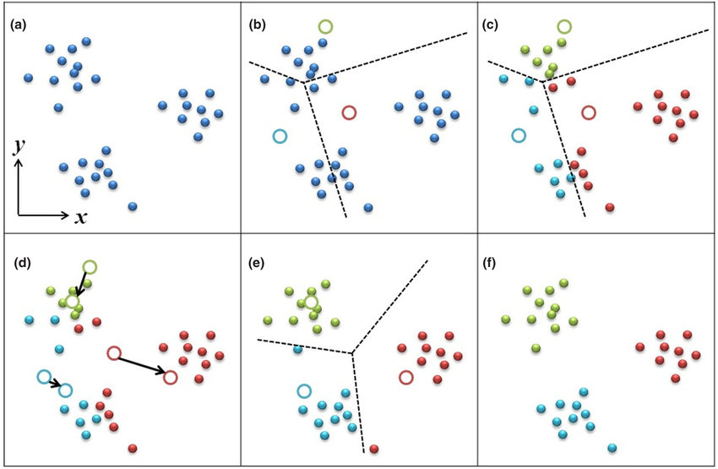
K-means
Highly dependent on the initial “seeds”
Notes:
Alternative hypothesis is usually what you’re trying to prove.

Slide 5
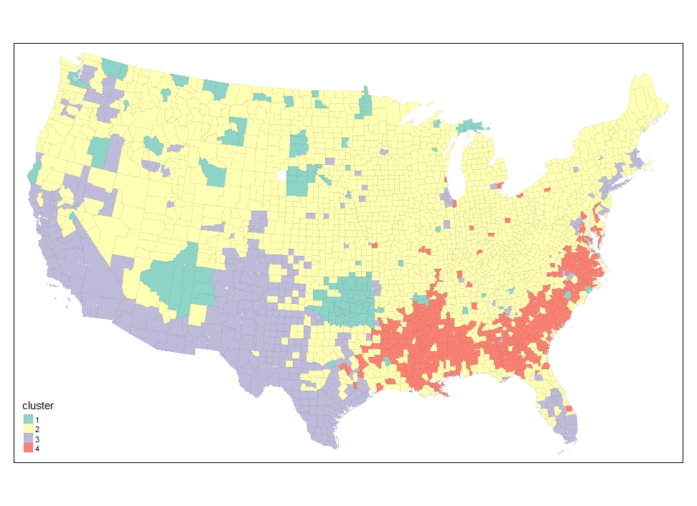
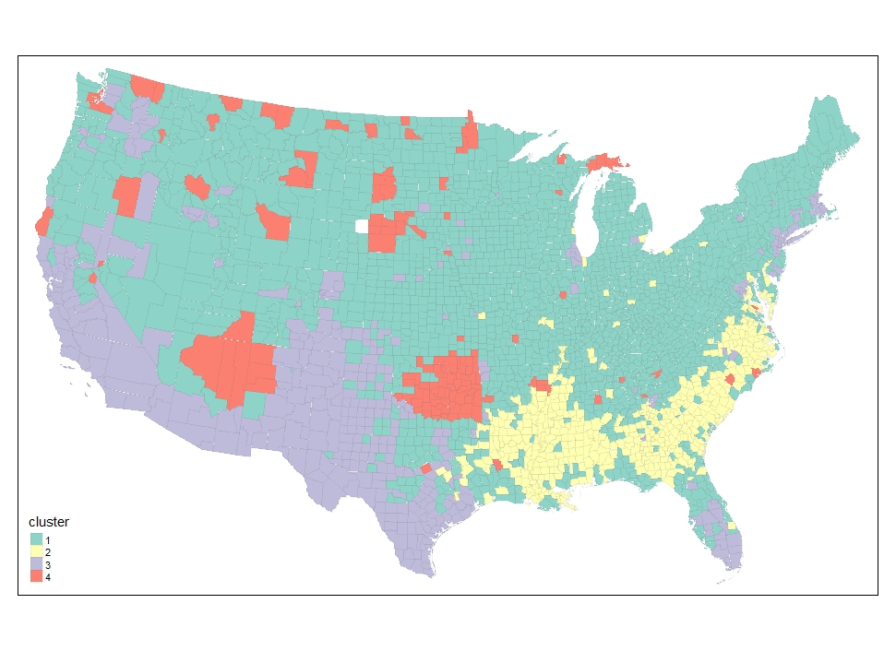
Let’s look at our county data!
Two cluster maps just based on the race/ethnicity variables
Notes:
Alternative hypothesis is usually what you’re trying to prove.

Slide 6
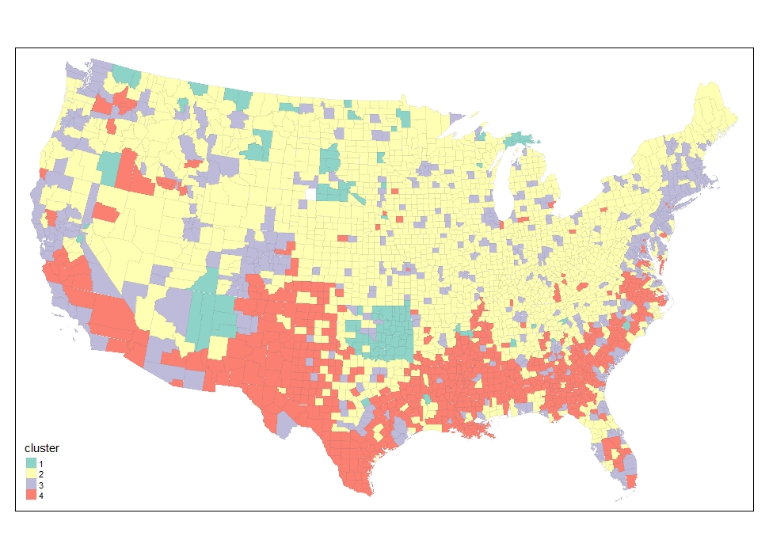
Let’s look at our county data!
Now let’s add in education variables
Race/ethnicity
Race/ethnicity + ed attainment
Notes:
Alternative hypothesis is usually what you’re trying to prove.

Slide 7
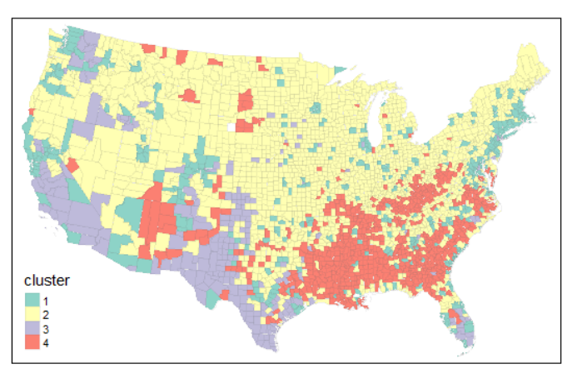
Let’s look at our county data!
Now let’s add in nativity variables
Race/ethnicity + ed attainment + nativity
Race/ethnicity
Race/ethnicity + ed attainment
Notes:
Alternative hypothesis is usually what you’re trying to prove.

Slide 8
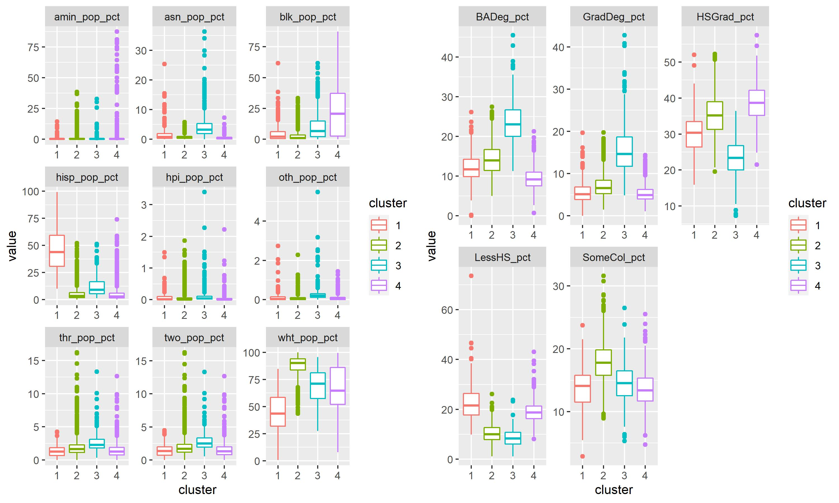
What do these clusters mean?
In groups:
Take one of these clusters and identify what makes it distinctive compared to the three others.
How would you title it?
Notes:
Alternative hypothesis is usually what you’re trying to prove.

Slide 9
Do these clusters make sense?
Race/ethnicity + ed attainment
Notes:
Alternative hypothesis is usually what you’re trying to prove.

Slide 10
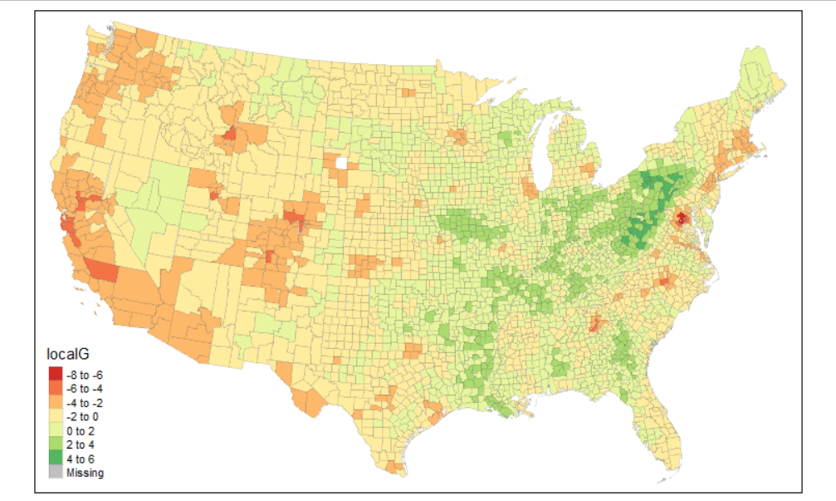
Clusters are different from spatial autocorrelation
Clusters:
Observations grouped by similarities across multiple variables
Spatial autocorrelation:
Neighboring areas with similar values for the same variable
HS Graduation is highest ed. attainment
Notes:
Alternative hypothesis is usually what you’re trying to prove.

